Slide 1

RETAIL ANALYTICS
Predictive Sales Analysis Carseats Revenue Model
Deploying a Random Forest classification model to forecast high-performing retail locations and optimize resource allocation.

Slide 2
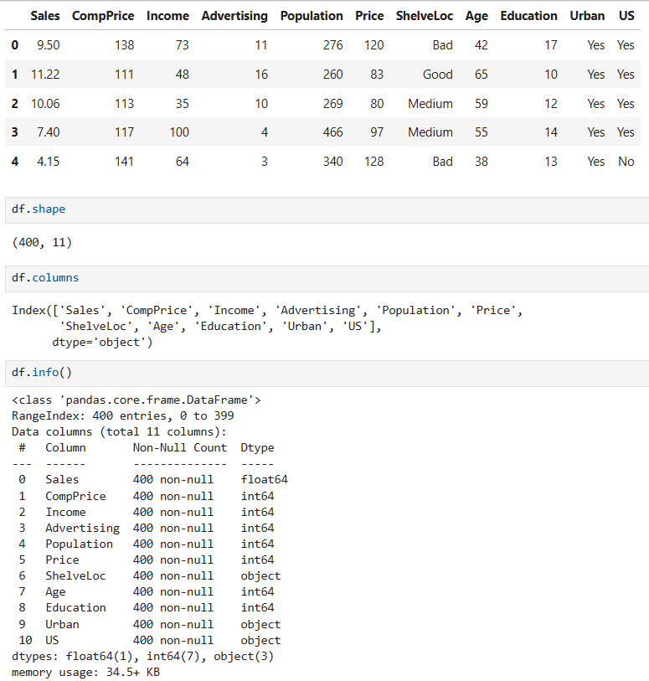

PROJECT OBJECTIVE & DATASET OVERVIEW
Business Goal
Retail sales for child car seats vary significantly by store. The objective is to identify the socio-economic and store-level drivers of "High Sales" vs "Low Sales" to optimize stock distribution and marketing spend.
Dataset: 400 records, 11 variables — Store features, Demographics & Categorical Sales Target

Slide 3
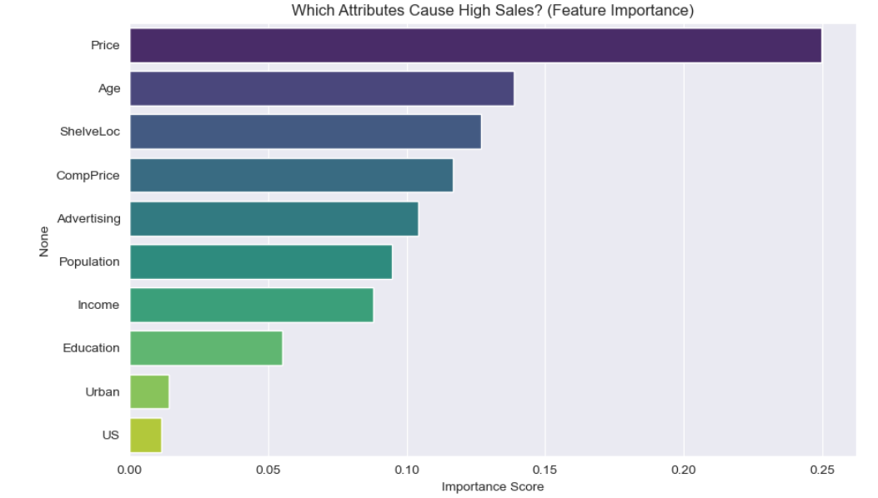

MODELING STRATEGY & FEATURE IMPORTANCE
Algorithm Choice: Random Forest Classifier utilized to handle mixed data types (categorical shelving locations, continuous pricing) and extract non-linear patterns.
80/20 train-test split applied.
Key Insight: The model revealed that in-store factors (like Shelf Location and Price relative to competitors) heavily outweigh macro-demographics like Urban/Rural status.

Slide 4




PERFORMANCE METRICS & BUSINESS INFERENCE
87.50%
0.88
0.88
OVERALL ACCURACY
PRECISION (HIGH SALES)
RECALL (HIGH SALES)
Metric Inference: Highly Balanced Forecasting
The model performs exceptionally well across both categories, with a macro average F1-score of 0.87. The "So What?": A Precision of 0.88 for the "High" class means that when the model flags a store as a top performer, it is correct 88% of the time. This drastically reduces "False Positives," ensuring the company does not waste inventory or targeted marketing spend on stores that will ultimately underperform.

Slide 5




CONCLUSION & NEXT STEPS
Model Accuracy
Key Takeaway
Next Steps
The Random Forest ensemble achieved a highly reliable 87.50% accuracy, demonstrating balanced precision and recall across 80 test instances.
Store-level execution is the primary growth lever. Shelf positioning and competitive pricing are vastly more predictive of sales volume than regional demographics.
Deploy model to score new retail partnerships. Additionally, run a separate regression pipeline to forecast exact continuous unit sales rather than binary categories.

